Slide 1
ITM – Mechatronic engineering Control systems in robotics ON/OFF control system for single axis arm John Isaac Junior Huertas Montes Jorge Torres Arboleda

Slide 2
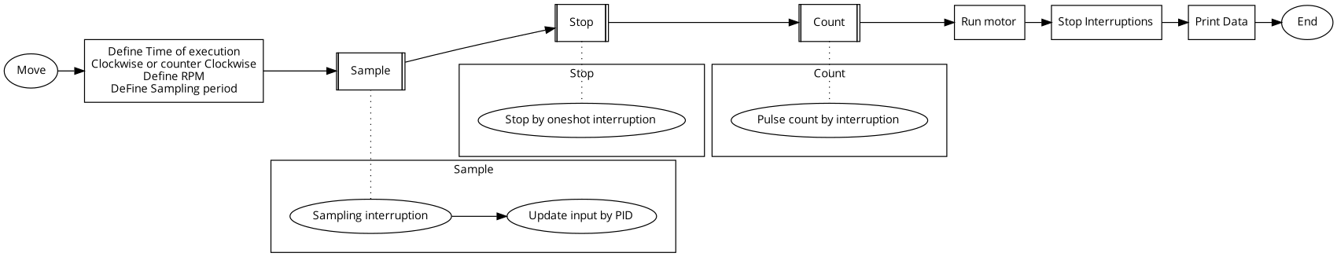
Flowchart
Figure 1. Flowchart.

Slide 3
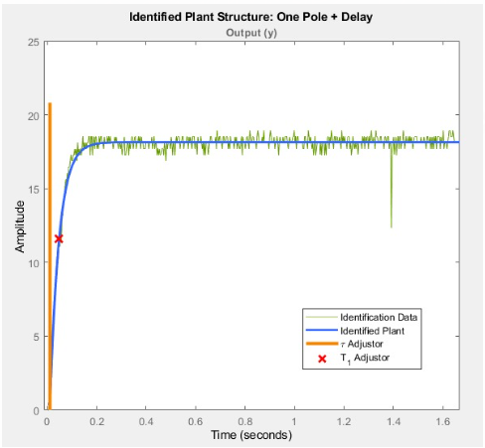
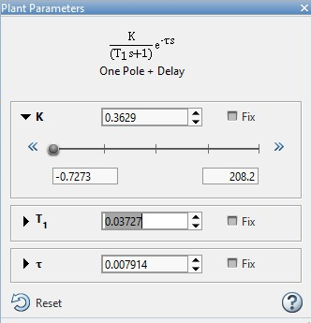
Controller tuning for POR system
Figure 3. Plant Parameters.
Figure 2. Identified Plant: One Pole.

Slide 4
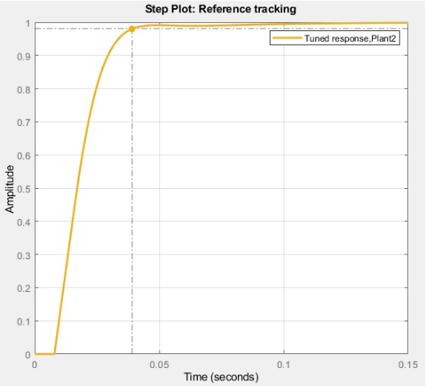
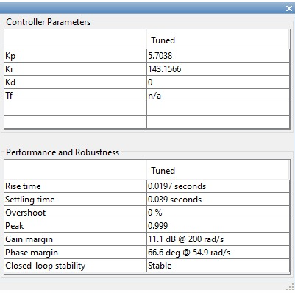
Controller tuning for POR system
Figure 5. Controller Parameters.
Figure 4. Tuned response.

Slide 5
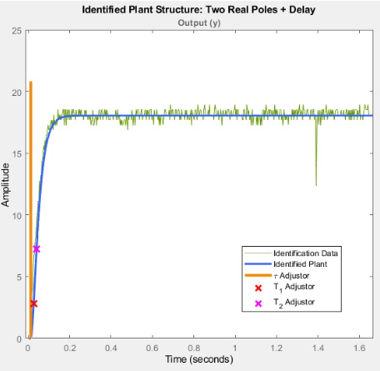
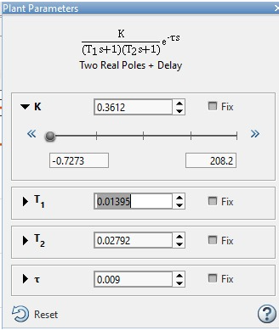
Controller tuning for SOR system
Figure 7. Plant parameters.
Figure 6. Identified plant: two real poles.

Slide 6
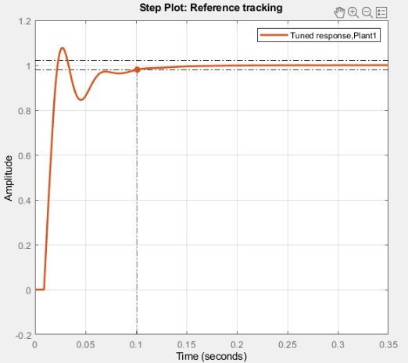
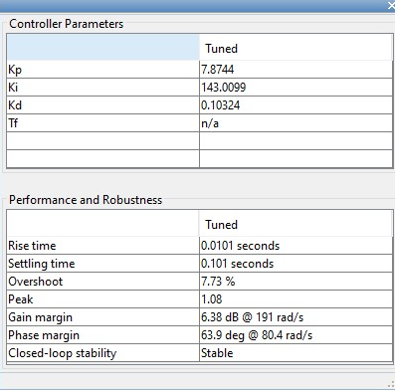
Controller tuning for SOR system
Figure 9. Controller parameters.
Figure 8. Tuned response.

Slide 7
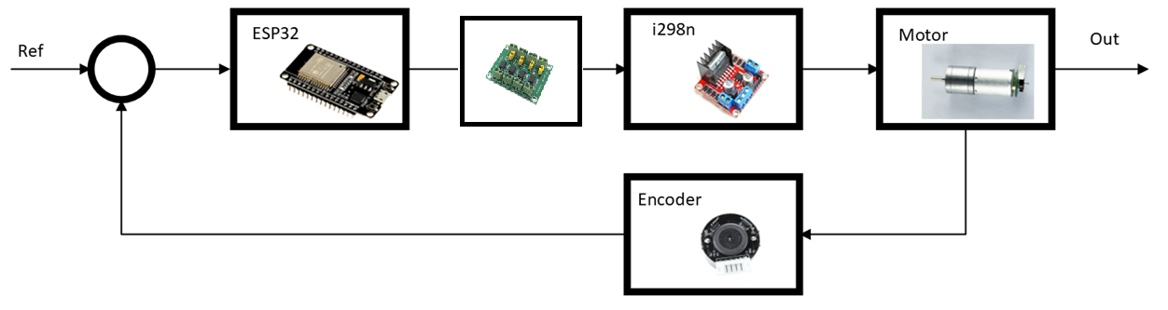
Control design
Figure 10. Control diagram

Slide 8
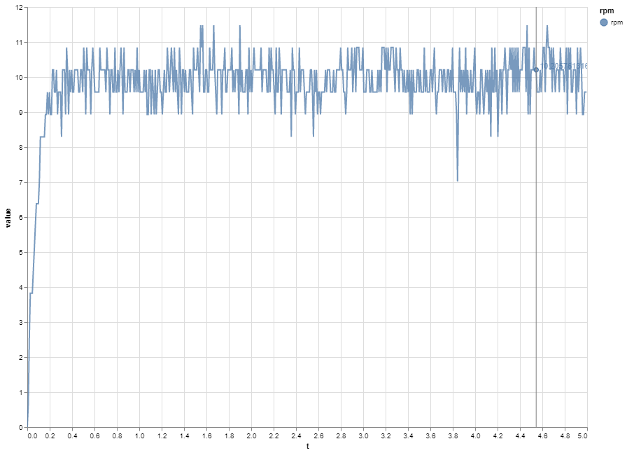
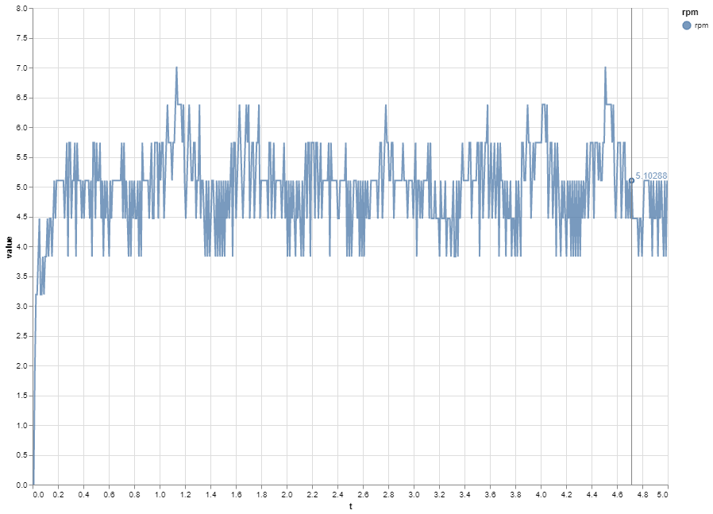
Data acquisition
Figure 11. Setpoint 10 RPM
Figure 12. Setpoint 5 RPM

Slide 9
References
https://www.sigmaelectronica.net/producto/esp-32/
https://components101.com/modules/l293n-motor-driver-module
https://www.didacticaselectronicas.com/index.php/elementos-electromecanicos/motores-y-solenoides-1/motores-dc-1/con-encoder/motorreductor-con-encoder-150-rpm-9-5kg-cm-gearmotor-de-25mm-para-robot-9vdc-mdc-enco-150r-9-5kg-motores-motorreductores-motoreductores-motor-reductores-dc-con-encoder-150rpm-detail
https://www.vistronica.com/robotica/motores/motorreductores/motorreductor-con-encoder-160-rpm-1-95-kg-cm-1-74-8-detail.html
https://grabcad.com/library
http://tecbolivia.com/index.php/venta-de-componentes-electronicos-11/actuadores/motor-dc-gm25-370-150rpm,-9v-para-carro-robot-detail

